Slide 1
Git
By Nadia Lucas
EPIC Orientation 2018

Slide 2
Git
A tool to manage the history of code
A revision control system

Slide 3
Github
An online hosting platform for projects that use git
There are many other hosting platforms like Gitlab and Bitbucket

Slide 4
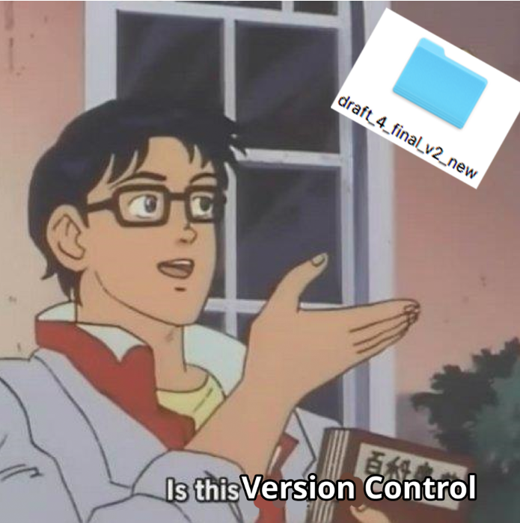
Version Control

Slide 5
Motivation
Common Programming Practices and some Quick Fixes

Slide 6
Version Control – one developer
Saving work at different snapshots in time
Different names for each version
Saving work from different locations – laptop or desktop
Save after every work session and specify which machine you worked from
Backing up work to the cloud
Pick snapshots in time where code is at a good point to push up to the cloud
Reverting fatally flawed code
A log of change histories would make this easy, with timestamps and a descriptor of what changes were made

Slide 7
Version Control – multiple developers
Multiple people working on different features of the project
One could write code that affects another person’s feature
E.g. cleaning an upstream variable that a collaborator uses downstream
Two developers working on the same feature in the project
You would need to keep a log of who is making what change so edits can be merged together

Slide 8
Dropbox
A more familiar version control system that automatically backs up all work to a single cloud storage location
This could be problematic if someone is working on a feature and wants to continuously save without having run some code that might affect someone else’s feature
It also creates confusion as to who has edited what and exactly what changes are made from version to version

Slide 9
Luckily there is something that does this automatically – Let’s venture out to Github to see how it works
Notes:
Have everybody go out and clone an already created repository

Slide 10
Git Terminology
Repository
A local or remote store of the versions
Working Copy
A local, editable copy of our project that we can work on
File
A single file in our project
Version/revision
A record of the contents of our project at a point in time
Change/diff
The difference between two versions
Head
The current version

Slide 11
How does Git store data?
Git stores snapshots of a project at different points in time in a log
Each snapshot is called a commit
A visual representation of the entirety of a project is the
object graph

Slide 12
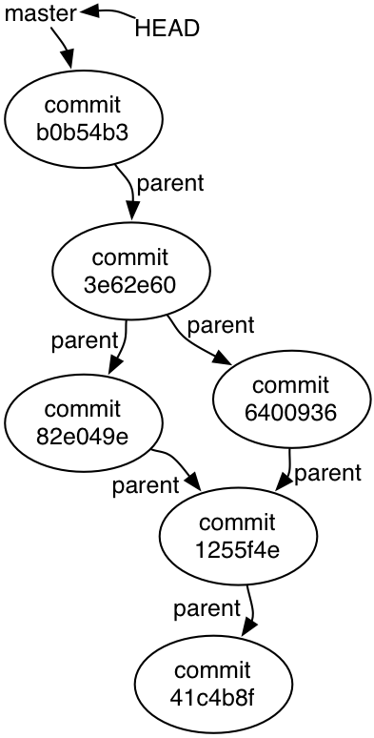
The object graph (Directed Acyclic Graph)

Slide 13
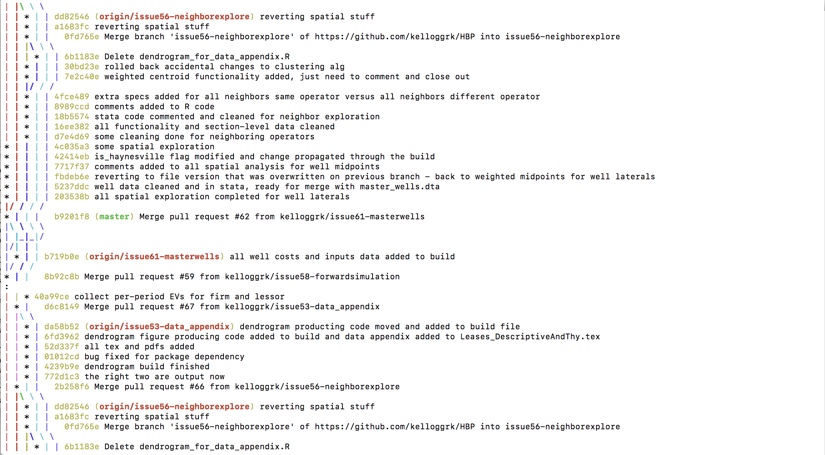
What does this look like in the wild?

Slide 14
Best Practices
Data on Dropbox, Code on Github

Slide 15
General workflow
A task is assigned via an Issue
You then must take out a branch specific to that issue to complete the task.
Add, commit, and push changes to the branch as you work along
Merge the branch back in with master via a pull request
Notes:
Real-time show the issue thing right now

Slide 16
Copy the object graph on your local machine
Every repository comes with an object graph
On github these start in the remote repository and must be copied to your local machine
This is done through cloning the repository on your local machine
git clone https://www.github.com/username/url/to/your/repository
Notes:
Have everyone clone the repo

Slide 17
Branching
Oftentimes when you work on a project with multiple developers, you may not want to be constantly pushing and pulling both your versions of the code to the project at the same time
A branch will take a snapshot of the object history at a certain point in time and let you work on it
git checkout –b <new-branch-name>
git checkout <branch name>
git branch
Notes:
Have everyone checkout a branch

Slide 18
Adding a commit to the object graph
git add .
This will add all changes made to a staging area
git add filepath/to/specific/file
This will add only specific changes made to a staging area
staging area: a proto-commit where we build up a snapshot of the commit itself
Notes:
Have them add lines of code to the bottom of hello.txt

Slide 19
git add
Modified: file.txt
Added:
hello.txt

Slide 20
Adding a commit to the object graph
git commit –m “some message to describe commit”
This sets in stone the commit as it is added to the object graph

Slide 21
git commit
commit 4fl39h4
parent
master
HEAD

Slide 22
Pushing
Once we commit, we have now added to the object graph on our local history. However, this doesn't end up in our remote history unless we push it up there
git push origin branch-name
Once we push, the remote object graph now matches the local object graph on our computer

Slide 23
git push
commit 4fl39h4
parent
master
push
HEAD
local
remote

Slide 24
git push
commit 4fl39h4
commit 4fl39h4
parent
parent
master
master
HEAD
HEAD
local
remote

Slide 25
Pulling (Merging)
Sometimes if you work on a branch in parallel with another developer, you may need to pull work from the remote object graph down to your own local machine
git pull origin branch-name
Why do you have to update the object graph manually?
You want your local copy of the object graph to be a work in progress and don’t want to worry if your local changes will break the code as a whole.
Notes:
Hop on someone’s branch in real time and have you both editing code but with best practices in pulling

Slide 26
Merge Conflict
Open conflicting files
Conflicting code will be wrapped in merge markers describing the origin of the conflict.
Remove the markers and keep all the code you would like in the final version
Let’s venture out to see how this works in the wild.
Notes:
First, I change a few lines in hello.txt and then have them add to it and then have them try to add, commit, push

Slide 27
Merging Branches
Once a branch is fully ready for deployment, it can be merged with another branch. General practice is to use the master branch as a baseline.
Developers will generally check out a branch as a snapshot of master, work on a feature and then merge their branch back in with master.
This is done through a pull request. A pull request is where you stage a branch for merge with master and
Notes:
Have them actually go through and do a pull request for their branch

Slide 28
Fetch remote branches
Say you have a team member working on some code on a different branch and you would like to check it out. Your local repository doesn’t know of that branch since pushing and pulling is branch-specific.
git fetch
git checkout <remote-branch-name>
Notes:
Maybe practice this if we have time?

Slide 30
Let’s go back to our log

Slide 31
Disaster Management
Undo staging area after adding changes
git reset <filename>
Undo a commit you just committed
git revert <commit-id-to-revert>

Slide 32
More Advanced Disaster Management
Undo all changes made in commits and move HEAD back to a specific commit
git reset --hard <commit-id>
Cherry pick a commit – move a commit from one branch to another to continue working off of that.
git cherry-pick <commit-id>

Slide 33
Forking
“A fork is a copy of a repository. Forking a repository allows you to freely experiment with changes without affecting the original project.
Most commonly, forks are used to either propose changes to someone else's project or to use someone else's project as a starting point for your own idea.”
-Github User Documentation

Slide 34
.gitignore
A file generally used to keep the github clean of auxiliary files that are often created when running code.

Slide 35
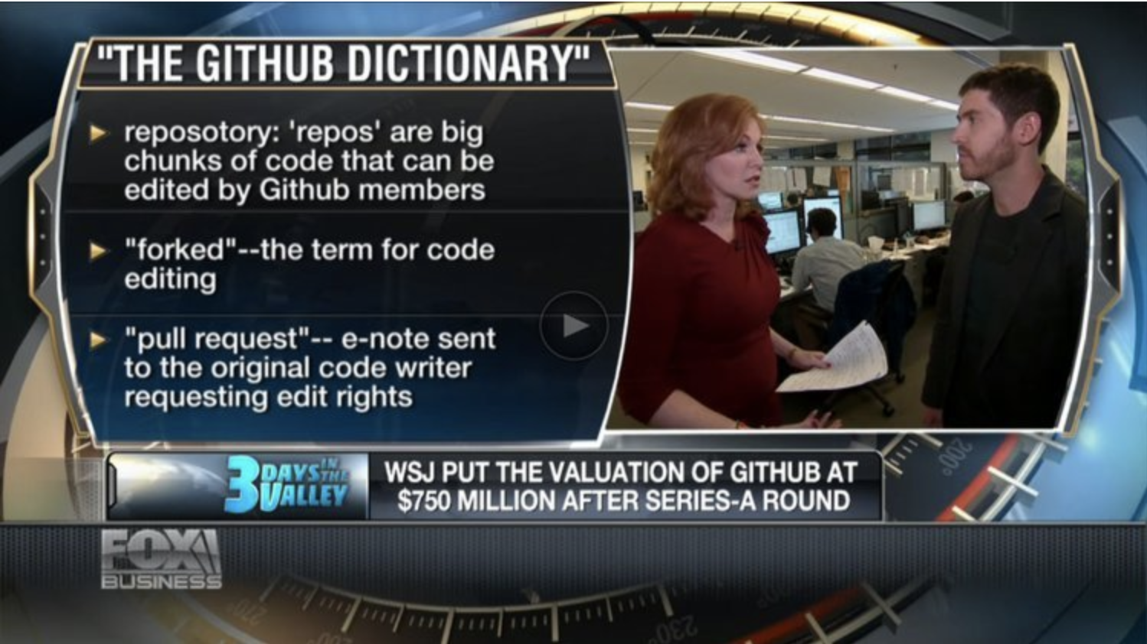
Now you’re smarter than Fox News!

Slide 36
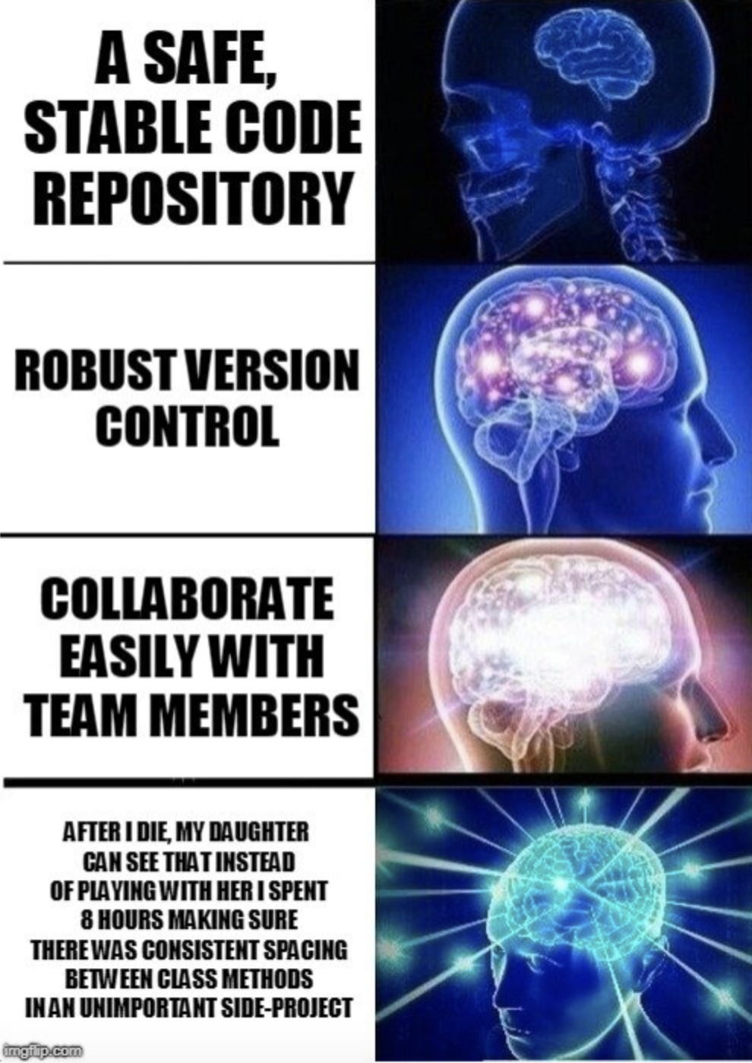
Why Git?

